Slide 1
Introduction to Components in App Inventor

Slide 2
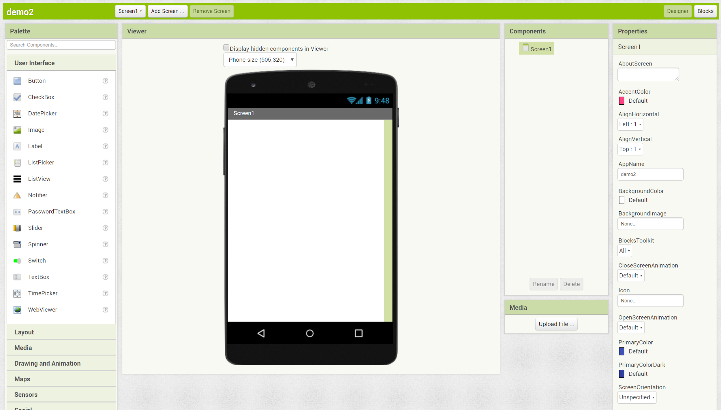
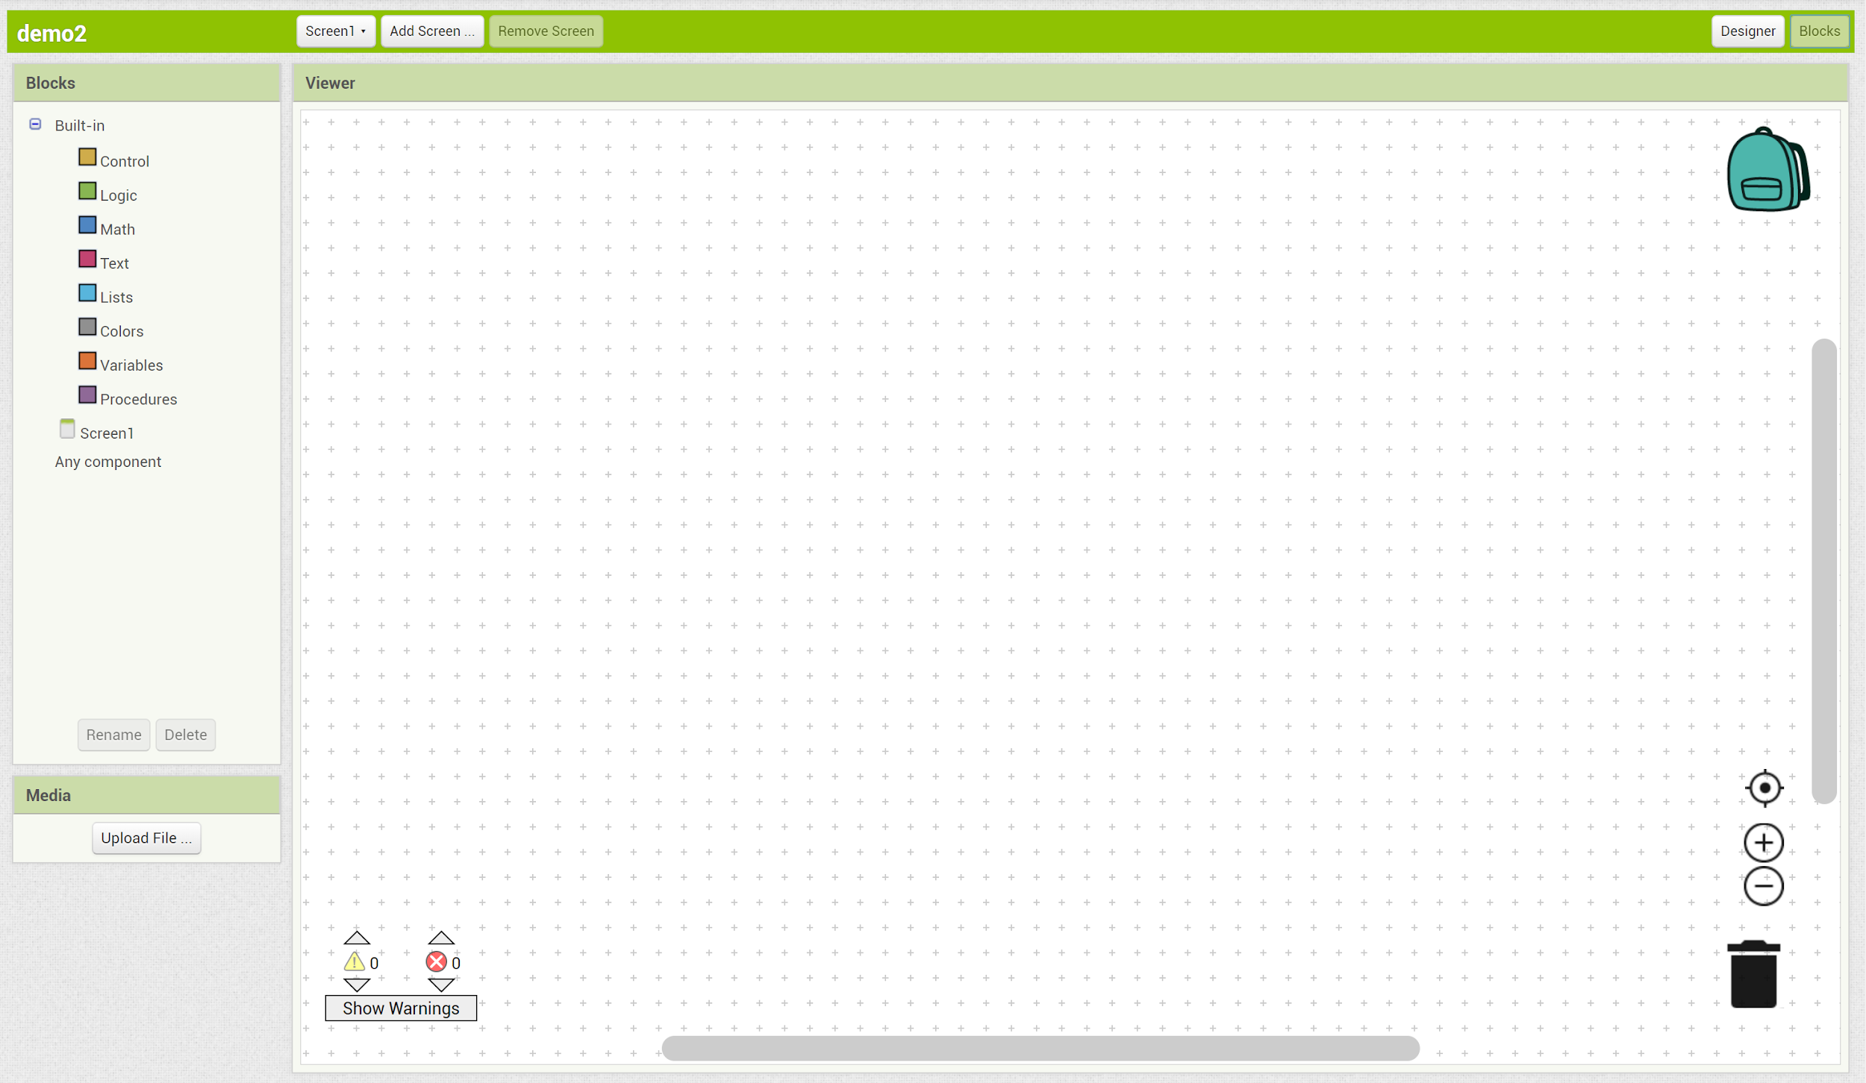
Designer vs. Block Display
Designer Display: Where you decide how the app will look and what components your app will need
Blocks Display: Where you code your app

Slide 3
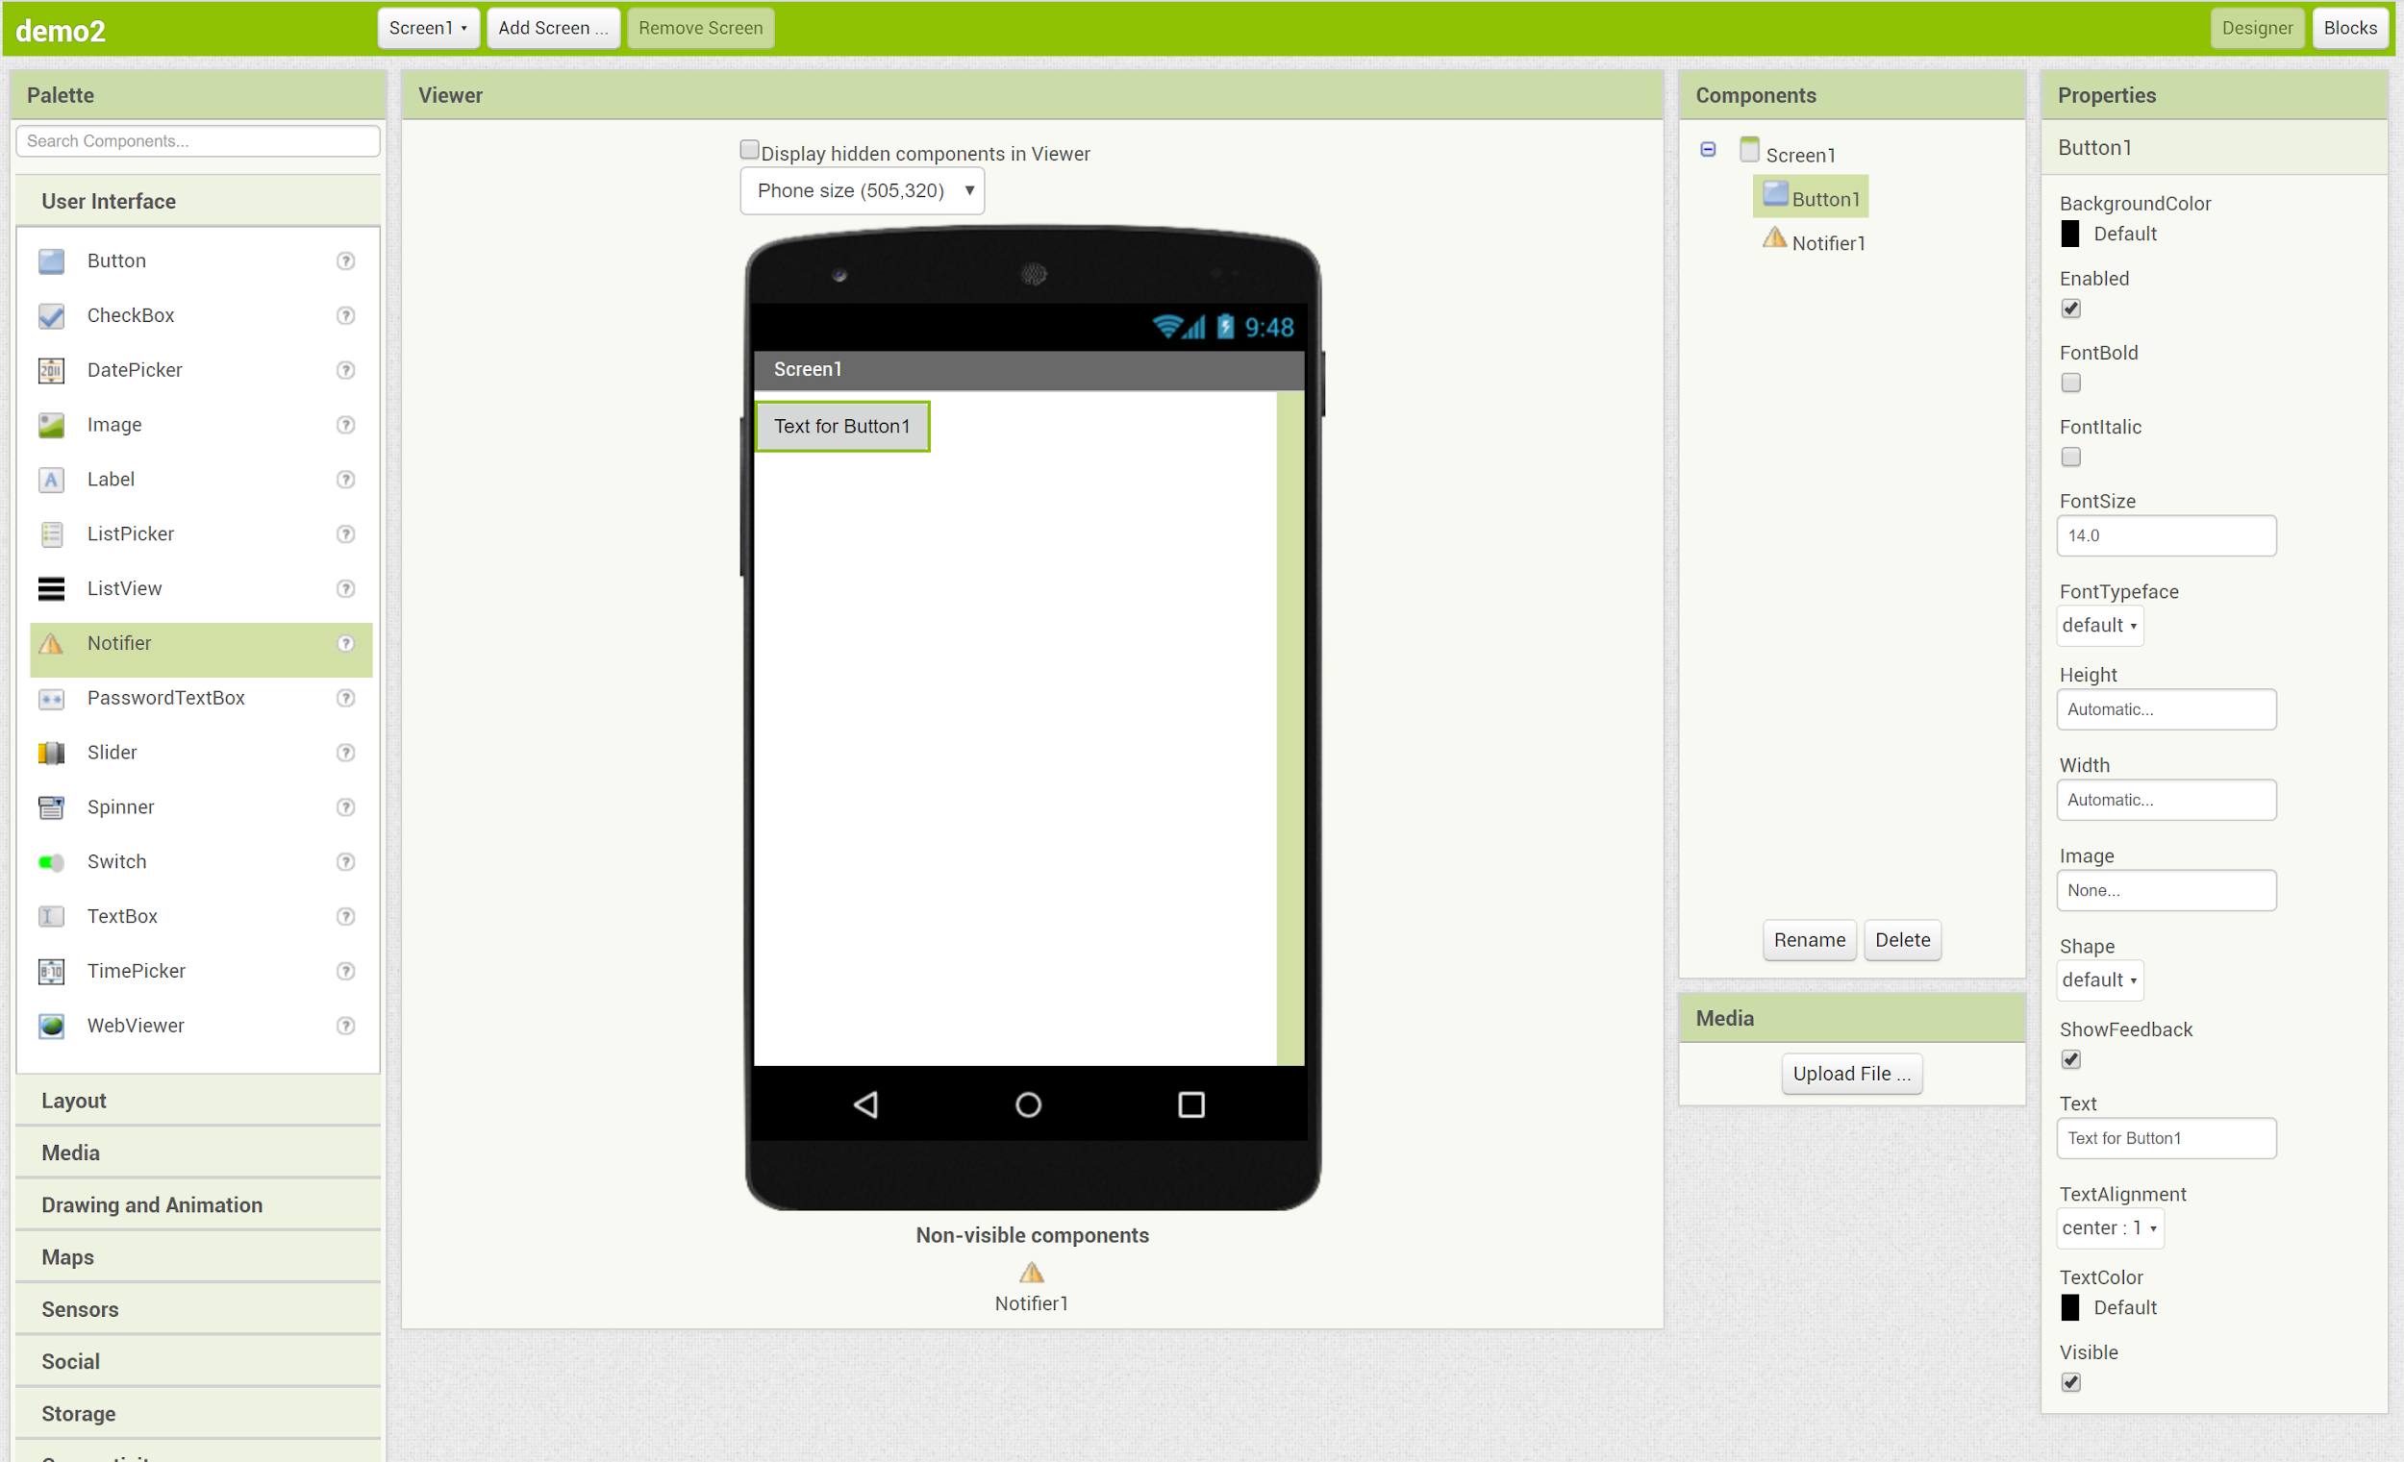
Intro to Designer
Display
Viewer: How your app will look on your phone
Component Properties: View which components you have already added and edit their properties
Palette: Where you choose which components you will add to your app

Slide 4
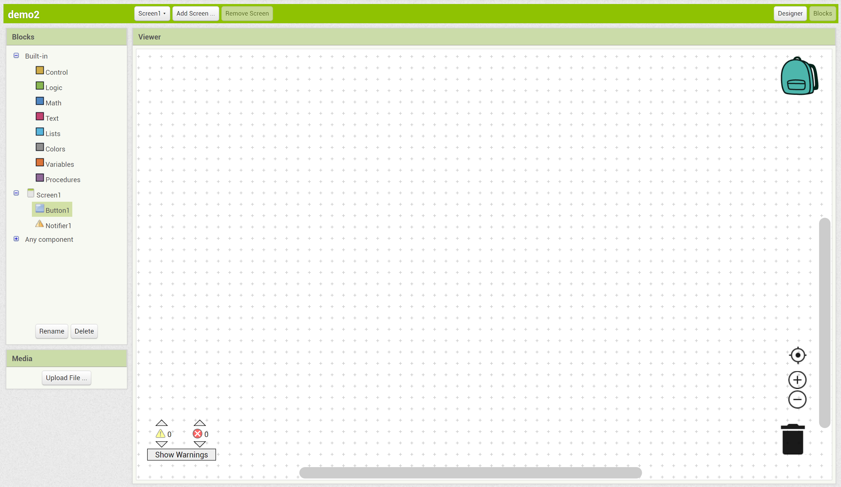
Intro to Blocks
Display
Viewer: Where you place blocks of code in order to program your app
Blocks: Each component comes with blocks of code that you can use

